Slide 1
FY ended Dec. 31, 2020
Tuesday, February 16, 2021

Slide 2
The forward-looking statements, including business forecasts, contained in this document are based on information currently available to the Company (MarkLines Co., Ltd.) and certain assumptions deemed reasonable by the Company. It is possible that these statements or assumptions may be objectively inaccurate or may not materialize in the future.
The information in this document concerning companies other than those in our group is quoted from public information, etc., and we do not guarantee the accuracy or appropriateness of said information.
MarkLines Co., Ltd.

Slide 3
Outline
Summary of FY ended Dec. 31, 2020
Financial Summary
Earnings Forecast
Growth Strategy

Slide 4
Summary of FY ended December 31, 2020

Slide 5
Summary of the FY ended December 31, 2020
Rapidly changing business environment
New coronavirus pandemic
In the first half of 2020, when the first wave of the COVID-19 pandemic hit, OEMs and auto parts suppliers moved to cut their budgets due to the deteriorating performance of the automotive industry, resulting in order cancellations for the Information Platform and other MarkLines businesses.
Lockdowns around the world necessitated widespread telecommuting, resulting in slow approval processes and causing delays in the timing of new orders.
Negative factors
The way people connect with each other in the business world has changed, and one-on-one online sales has become more popular than face-to-face sales. In addition, MarkLines has been able to develop more efficient sales activities, such as the introduction of one-on-one format briefing sessions.
With the cancellation of exhibitions held at venues such as event booths, attention turned to our LINES service, which can be used to promote online.
Changes in work styles have led to the widespread use of remote work, which in turn has led to the digitization of business operations, including the digitization of invoices.
Positive factors

Slide 6
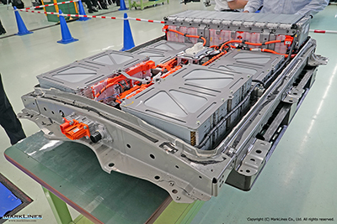
Summary of the FY ended December 31, 2020
Rapidly advancing electrification
The trend toward electrification is accelerating in the automotive industry, with the rise of Tesla and other EV manufacturers against the backdrop of more stringent environmental regulations around the world. As a result, there is growing interest in the Information Platform and content that MarkLines provides, such as EV sales figures and model change data. In addition, the number of projects related to electrification increased in our Consulting and Benchmarking related businesses.

Slide 7
Summary of the FY ended December 31, 2020
Impact of changes in the business environment on our business performance
Information Platform business
Due to the first wave of the COVID-19 pandemic, the monthly net increase in the number of member companies dropped sharply in August. Since then, that number has been picking up.
Impact of the first wave of the COVID-19 pandemic
Monthly net increase in the number of companies
Businesses other than the Information Platform
Changes in the business environment had a positive impact on some services, but overall Q2 sales were down from the previous quarter due to the impact of the first wave of the COVID-19 pandemic.
JPY Millions

Slide 8
Summary of the FY ended December 31, 2020
Benchmarking-related business
Market forecast information sales business
Sales of teardown survey data were strong, including sales of drive motors for electric vehicles. In the vehicle and parts procurement agent business, although there were delays in the shipment of products due to the impact of the COVID-19 crisis, sales growth was remarkable due to an increase in the number of inquiries related to electrification.
Sales decreased from the previous quarter due to postponement of contract renewals in Q2.
Benchmarking-related business sales (quarterly)
JPY Millions
JPY Millions

Slide 9
Summary of the FY ended December 31, 2020
Consulting business
Recruiting Solutions business
Sales declined significantly quarter-over-quarter due to postponement of orders in Q2 due to stalled approval processes.
The impact of the hiring freezes in Q2 lingered, and new contract signings were soft.
JPY Millions
JPY Millions

Slide 10
Summary of the FY ended December 31, 2020
Promotional Advertising business
Amidst the continued cancellation of actual in-person exhibitions, our Promotional Advertising business has attracted attention as an online promotional tool, and sales have been strong since the second quarter due to the increased use of PR emails and banner ads.
JPY Millions

Slide 11
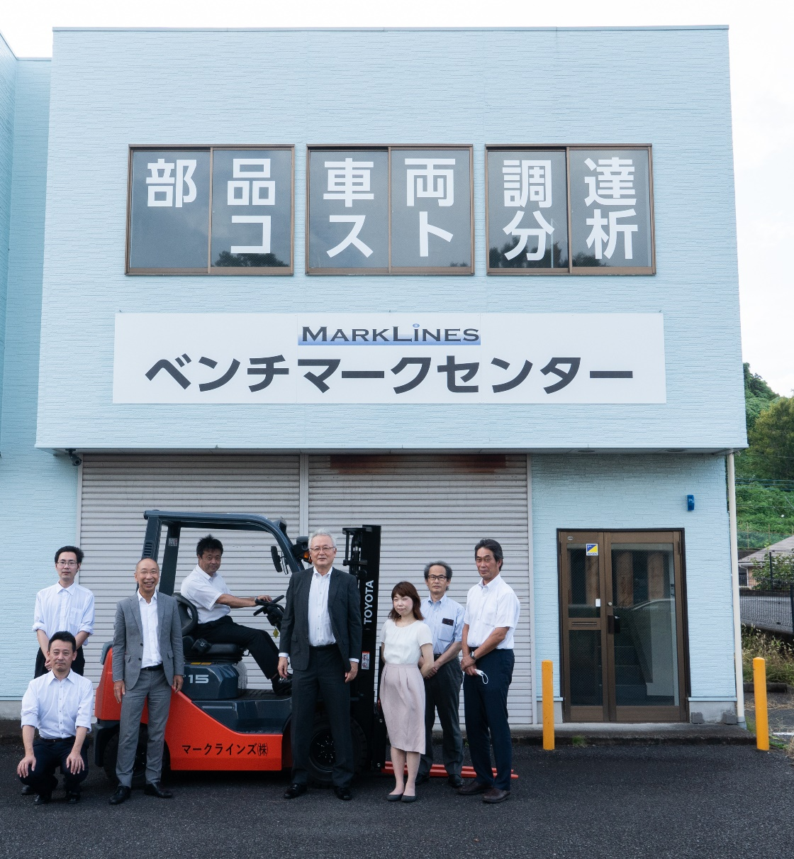
Summary of the FY ended December 31, 2020
Opening of Benchmarking Center
In September 2020, we established a Benchmarking Center in Atsugi City, Kanagawa Prefecture, to quickly and efficiently operate the highly compatible "Vehicle and Parts Procurement Agency" and the "Cost Comparison Analysis" services.

Slide 12
Summary of the FY ended December 31, 2020
Established the Automobile Fund Co., Ltd.
We established this subsidiary to support the automotive industry in terms of financing, utilizing the strengths of our group, such as management know-how, information capabilities, and the discernment of specialized human resources, which we have cultivated through our own growth process as a venture company.
Outline of the subsidiary
Company name | Automobile Fund Co., Ltd.
Location | Sanno Park Tower 14F, 2-11-1 Nagatacho, Chiyoda-ku, Tokyo
Description of Business | Acquisition and ownership of securities Operation and management of the assets of investment partnerships and limited liability investment partnerships, and investment in investment partnerships and limited liability investment partnerships, etc.
Date of establishment | April 1, 2020
Capital | 50 million yen
Investment ratio | MarkLines: 100%
Representative | Chairman and Representative Director Makoto Sakai President and Representative Director Aya Miyake

Slide 13
Summary of the FY ended December 31, 2020
Relocation of offices in China, Germany and Japan headquarters
With a view to reinforcing our global management system, we launched new companies in China in January, in Germany in February, and in Japan in December.
In addition, our head office was expanded and relocated at the end of March, 2020 to accommodate the increase in personnel.
Shanghai Office
Frankfurt Office
Tokyo Head Office

Slide 14
Summary of the FY ended December 31, 2020
Strengthening the content of the Information Platform
Business alliance with Springer Fachmedien Wiesbaden GmbH (Springer)
Report on self-driving shuttle buses, courtesy of Springer
Springer publishes technical journals and other publications aimed primarily at engineers and social scientists. Through this partnership, the company will reprint 12 articles per year from ATZ, the world's oldest automotive technology magazine, which was first published in 1898.
Sales volume information for diesel engines in Germany
Enhanced the following content for Germany and China:
Newly added sales figures for diesel vehicles in Germany.
Newly added information on the number of retail units registered in China.

Slide 15
Financial Summary

Slide 16
Summary of Consolidated Financial Results
Record-high profits for the 10th consecutive year
(Unit: Millions of yen)
 | 2020 Actuals | Change y/y (%) | Primary factors
Consolidated net sales | 2663 | +11.9 | The "Information Platform" business increased by 10.1% from the previous fiscal year. For the other businesses, our benchmarking-related business and promotional advertising business increased significantly from the previous fiscal year, but growth in the consulting and recruiting businesses slowed due to lower-than-expected results in the previous fiscal year. Overall, sales were up 11.9% y/y.
Consolidated operating income | 960 | +9.9 | Affected by the slowdown in sales growth, sales increased only 9.9% y/y.
Consolidated ordinary income | 957 | +8.2 | Operating income increased by 8.2% y/y due to the limited growth of 9.9% y/y and the impact of foreign exchange losses.
Net income attributable to shareholders of the parent company | 630 | +3.0 | Increased by 3.0% y/y due to the impact of a JPY 56 million loss on the valuation of investment securities.

Slide 17
Business segment profit and loss
(Unit: JPY Millions)
Business |  | 2019 Actuals | 2020 Actuals | Change from previous period
Information Platform business | Net sales | 1,748 | 1,925 | +176 | +10.1%
 | Segment profit (loss) | 959 | 1,085 | +125 | +13.1%
Benchmarking-related business | Net sales | 156 | 277 | +120 | +77.4%
 | Segment profit (loss) | 39 | 65 | +25 | +64.9%
Market Forecast Information sales business | Net sales | 128 | 138 | +10 | +7.9%
 | Segment profit (loss) | 30 | 35 | +5 | +16.6%
Consulting business | Net sales | 203 | 191 | (12) | (6.1%)
 | Segment profit (loss) | 56 | 33 | (23) | (40.9%)
Promotional Advertising business | Net sales | 23 | 36 | +13 | +56.4%
 | Segment profit (loss) | 14 | 24 | +10 | +70.5%
Recruiting Solutions business | Net sales | 119 | 93 | (26) | (21.9%)
 | Segment profit (loss) | 36 | 19 | (16) | (45.8%)
Adjustments | Net sales | － | － | － | －
 | Segment profit (loss) | (263) | (303) | (40) | +15.3%
Consolidated net sales |  | 2,380 | 2,663 | +282 | +11.9%
Consolidated operating income |  | 874 | 960 | +86 | +9.9%

Slide 18
Business segment profit and loss
Information Platform business
The Information Platform business was affected by the COVID-19 pandemic from April 2020, and the number of companies with a monthly net increase plummeted in August. Since then, the Information Platform business has been picking up.
As one of our business strategies, we were successful in the acquisition of unrestricted user contracts from German and American OEMs.
We also focused on regions such as China, where the impact of the COVID-19 pandemic has diminished.
As a result of the above, net sales increased by 10.1% y/y, and operating income increased by 13.1%.
JPY 1.925 billion
JPY 1.748 billion
JPY 1.085 billion
JPY 959 million

Slide 19
Business segment profit and loss
Benchmarking-related business
Vehicle and parts procurement agency: Sales increased by 110.6% y/y to JPY 178 million due to an increase in large-scale projects such as the procurement of vehicle bodies on behalf of customers, and an increase in inquiries in this area as the trend toward electrification has accelerated.
Sales of teardown survey data: Sales increased by 38.0% y/y to JPY 98 million due to strong sales of electric drive motors for electric vehicles, the Tesla Model 3 and other electrification-related reports.
JPY 277 million
JPY 156 million
JPY 65 million
JPY 39 million
Market Forecast Information sales business
Despite an increase in the number of companies that decided to postpone renewing their contracts in Q2, from Q3 onwards, some companies switched from other companies' products due to our price competitiveness. They also purchased our products as a tool to predict recovery scenarios for the automotive market. As a result, sales increased by 7.9% y/y and operating profit increased by 16.6% y/y.
JPY 138 million
JPY 128 million
JPY 30 million

Slide 20
Business segment profit and loss
Consulting business
Since the beginning of the year, there has been a strong demand for our "cost comparison analysis service" and other electrification-related services, but the growth in new orders stagnated in Q2 due to the COVID-19 pandemic. Subsequently, the company’s financial health began to recover by winning orders for projects in new business areas such as corporate restructuring support, but net income declined by 6.1% y/y. Operating income decreased by 40.1% y/y, partly due to increased labor costs.
JPY 203 million
JPY 191 million
JPY 56 million
JPY 33 million
Promotional Advertising business
With the cancellation of actual exhibitions due to the COVID-19 crisis, digital marketing, such as virtual exhibitions, LINES has become the focus of attention as an alternative to in person sales. As a result, sales increased by 56.4% y/y and operating profit increased by 70.5% y/y.
JPY 36 million
JPY 23 million
JPY 24 million
JPY 14 million

Slide 21
Business segment profit and loss
Recruiting Solutions business
JPY 128 million
The impact of hiring freezes in Q2 lingered, and the number of new contracts signed was soft at 45 (58 in the previous fiscal year), resulting in a 21.9% decrease in sales and a 45.8% decrease in operating profit compared to the previous fiscal year.
JPY 93 million
JPY 30 million
JPY 19 million

Slide 22
Sales summary by region for the "Information Platform" business
(Unit: JPY millions)
Information Platform business | 2019 | 2020 | y/y （％）
Japan | 962 | 1,019 | +5.8
China | 211 | 250 | +18.0
Asia | 244 | 280 | +14.9
North America | 155 | 176 | +13.9
Europe | 163 | 187 | +14.6
Other | 10 | 10 | +5.2
Total | 1,748 | 1,925 | +10.1
Growth slowed due to the focused allocation of domestic sales resources to overseas sales.
Sales increased further in the current fiscal year due to the relatively early convergence of the COIVID-19 crisis and the depreciation of the JPY.
Sales also increased as a result of relatively strong new user contract acquisitions in Thailand, South Korea, and India.
As a result of focused efforts to develop business with Japanese companies in the U.S. and Mexico, sales increased by double digits.
This business continued to perform well, including winning an unrestricted contract from Daimler.

Slide 23
Composition of "Information Platform" business by Industry and Occupation
Composition of client member companies by industry
Composition of Information Platform paying members by job type

Slide 24
Sales by Region for the Information Platform business
Sales in each region, excluding Japan, grew by double digits, accounting for 47.1% of total sales. Currently, the ratio of new overseas contracts has been about 60-70%, and the ratio of overseas sales is increasing yearly.

Slide 25
Number of Client Members in the Information Platform business
As of the end of December 2020, the number of companies with Information Platform contracts increased by 371 companies y/y to 3,637 companies. Despite the impact of the COVID-19 pandemic, the net increase in the number of subscribers was maintained at about the same level as the previous fiscal year.

Slide 26
Earnings Forecast

Slide 27
Full-year Earnings Forecast
(Unit: JPY millions)
 | 2020 Results for Fiscal Year ended December 31 | 2021 Plan for Fiscal Year Ending December 31 | Change from the previous year (%)
Consolidated net sales | 2,663 | 3,100 | +16.4%
Consolidated operating income | 960 | 1,100 | +14.5%
Consolidated ordinary income | 957 | 1,050 | +9.7%
Net income attributable to shareholders of the parent company | 630 | 730 | +15.8%
The exchange rate assumptions for the fiscal year plan ending December 2021 are as follows: USD103 yen, EUR123 yen, CNY15.6 yen, THB3.4 yen

Slide 28
Forecasting an 11th consecutive year of record profits
(Unit: JPY millions)

Slide 29
Growth Strategy

Slide 30
Our Vision
Aiming to establish ourselves as a platformer in the automotive industry over the next 10 years
Seller
Buyer
Engineering,
Consulting, research firms,
Materials manufacturers, machinery suppliers,
Prototype suppliers, etc.
Paid members belonging to
OEMs and Tier 1 auto parts suppliers, and departments such as development and purchasing
What do we mean by the term "platformer"?
1． We can stand between the demand side and the supply side, mediate between the two, and create new value.
2． We can provide a wide variety of one-stop services.
3． We can provide a common platform (Information, in our case) like a chassis.

Slide 31
1． Measures to realize a platform for the automotive industry
Seller side development
To provide a variety of information content and services to attract buyers, we will utilize our eight global offices to develop new seller-side business partners.
※
※Main business partners to date: LMC Automotive Ltd.
Munro & Associates, Inc.
Buyer side development
To acquire new contracts from European OEMs (VW, BMW) with whom we have not yet signed.
In addition to obtaining unlimited contracts from European and U.S. OEMs with only a small number of users, we will promote registration to increase the number of users to 5,000 per OEM.
Acquire new unlimited contracts other than those mentioned above, and promote the upgrade of existing client members to unlimited contracts to further increase the number of members who become product buyers. The goal is to double the number Information Platform users over the next three years.

Slide 32
Launch of the Automobile Fund business
Our subsidiary, Automobile Fund Co., Ltd. established the "Automobile Industry Support Fund 2021" on January 29, 2021 in collaboration with SBI Capital Co., Ltd. and started investment activities in earnest.
Growth curve image of portfolio companies
Companies to be invested in
Venture Startup
Venture startups
Re-innovation
In the process of corporate growth
Hands-on support
HR Introductions
Startup
Management structure of the fund
Expand sales channels
Re-innovation Reorganization and Re-founding
A management structure has been established with executives and investors with expertise in the automotive industry. Move investment activities to the execution phase.
Consulting
Growth and Expansion

Slide 33
Enhancement of "Information Platform" content
The search function for model change information will be enhanced to enable data extraction from multiple perspectives, thereby improving convenience for users.
CASE (electrification and autonomous driving) information page
Strengthen local technical exhibition reporting by increasing the number of personnel in our China and Germany subsidiaries.
For the information on the number of units, the detailed classification of HVs will be added to enhance the content.

Slide 34
Benchmarking
Teardown Survey Data sales
JPY millions
By identifying new business partners, we will expand our lineup of new sales reports, such as performance test data, to stimulate latent demand from Information Platform members.
JPY millions
Vehicle and Parts Procurement agent services
We will continue to promote this service to our Information Platform members through trade shows and targeted mailings.
100
%
80
60
40
20
0

Slide 35
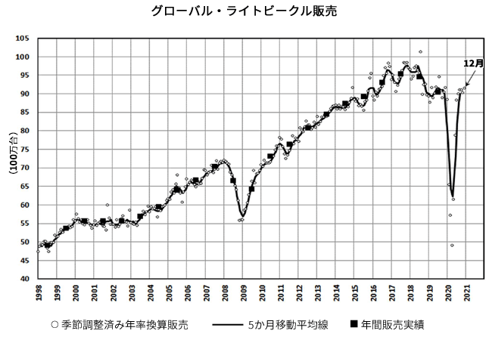
Sales of LMC Automotive Ltd. products (market forecast information)
Expanded measures to send promotional e-mails to Information Platform members who view forecast-related content. Aiming to further increase contact points with prospective customers.
In 2020, some customers canceled their contracts due to the unstable market outlook caused by the COVID-19 crisis. In 2021, it is expected that there will be a need among these companies to predict the pace of market recovery, so we will strengthen our contacts to have them become customers again.

Slide 36
Consulting
Due to the progress of electrification, the needs for consulting for business reform and new business development and technology trend survey are becoming more active. In 2021, we will expand the scope of our activities by expanding into problem-solving consulting for companies.
Our cost comparison analysis service has been growing steadily over the past three years due to an increase in new customers and repeat customers. And we will continue to strengthen our systems, improve the efficiency of analysis operations, and expand capacity in response to the increase in orders.
Composition of FY2020 net sales by service

Slide 37
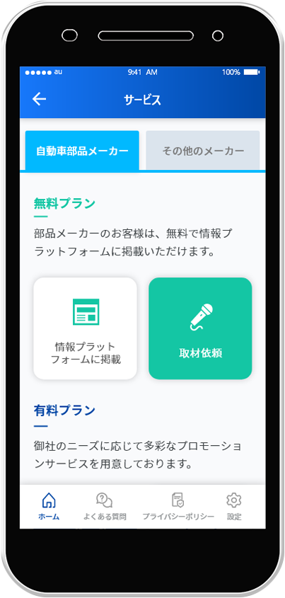
Promotional Advertising (LINES)
It is estimated that online exhibitions and seminars will continue to be held and the shift to digitalization will continue this year. In particular, we will focus on approaching equipment, machinery, and solution companies, for which we have strong inquiries.
By releasing a smartphone version of the "Promotion App", companies considering sales promotion of their products and services will be able to more easily access and raise awareness.
Expand sales of LINES at overseas offices.
Orders received:
Image of the smartphone version of the "Promotion App”

Slide 38
HR Introduction
We will create a database of management and high-level career human resources, and promote new activities such as proposing HR talent that matches the potential needs of Information Platform member companies, in addition to activities based on referral requests from client companies.
To respond to the demand for human resources that arises in the process of management support consulting to solve issues faced by companies, such as the transition to CASE technologies and business restructuring, we will collaborate with the Consulting and the Automobile Fund businesses.
Composition of contracts signed in FY2020 by tier

Slide 39
MarkLines SDG and ESG Initiatives
Provision of information, knowledge, and human resources for electrification toward zero CO2 emissions
Helping the mobility impaired by providing information on autonomous driving technologies
Promotion of digitization through Internet businesses
Promote internal human resources regardless of age, gender, educational background, or nationality.

Slide 40
Thank you very much for your attention.

